Slide 1

Journey Through Crystal Peaks
A Puzzle Game, For AIE Cross-Platform Development,
By Flynn May

Slide 2
Pitch
Find yourself in a world fueled by magic and the will to explore. Journey through various levels solving challenging puzzles, with increasing difficulty, by guiding wisps to the light.

Slide 3

Target Audience
Journey Through Crystal Peaks, is a game for puzzle lovers, espescially thoughs who have played the monument valley series.
Our game is suitable for all ages, and tries to encourage the player to sit back and relax while still keeping their minds active.

Slide 4
Table of contents
01
Player
04
Cross-Platform
02
Wisps
05
Assets & Software
03
Interactables
06
GUI Wireframes
Movement
Pushing
Android
Windows
Web
Movement
Interaction
Software
Assets
Events
Core Interactors
Menu
Volume Settings
Level Select
Game Window
Level Complete

Slide 5
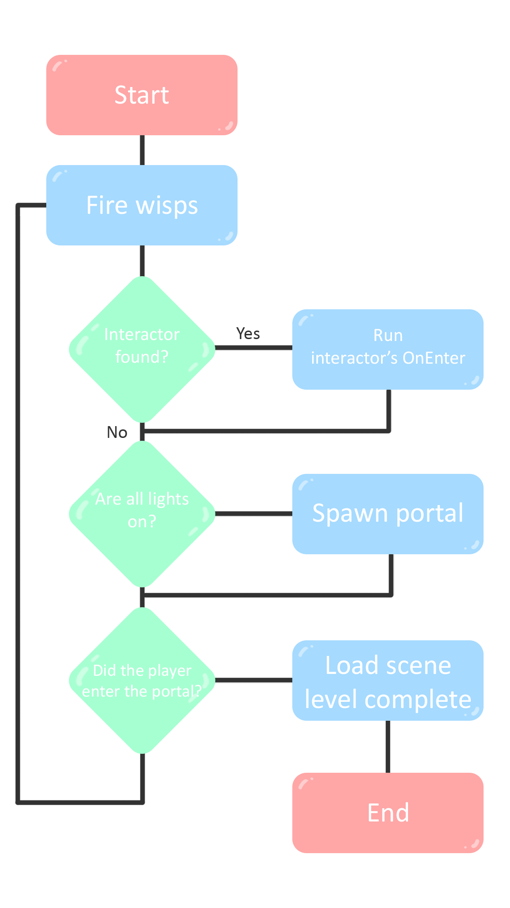
Flow
How is the game played?

Slide 6
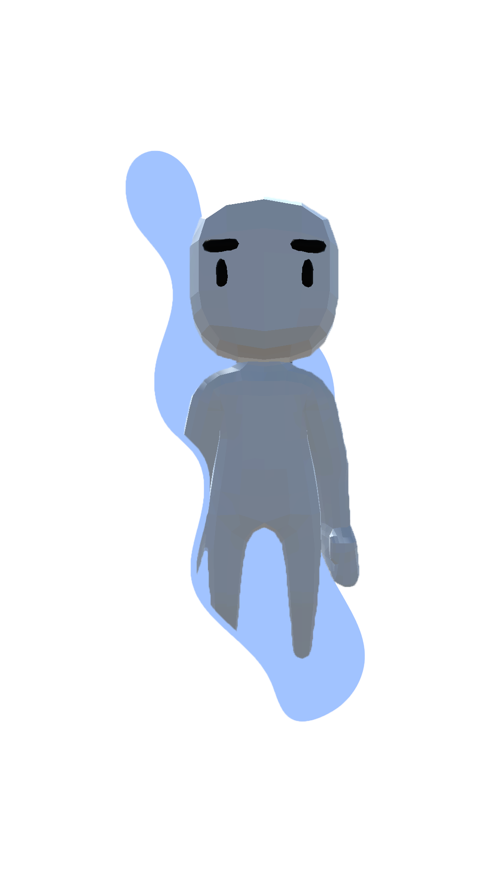
01.
Player
Find the model here...

Slide 7
Movement – Click To Move
Code
Effect
Shoot a raycast from the mouse, if the player clicks and the found object is a ground tile, use unity’s nav mesh system to path to that point, the movement is invalid if either the x or z axis are not the same
The user can click a tile on the scene and if the path is a straight line the player can path to it

Slide 8
Pushing Objects
Code
Effect
Using unity triggers if a player paths and enters a objects trigger, that object will lerp to the next position slightly faster then the players speed, if another object is in the way (detected by a raycast) it is also pushed.
When the player is walking, it can push an object one tile at a time.

Slide 9
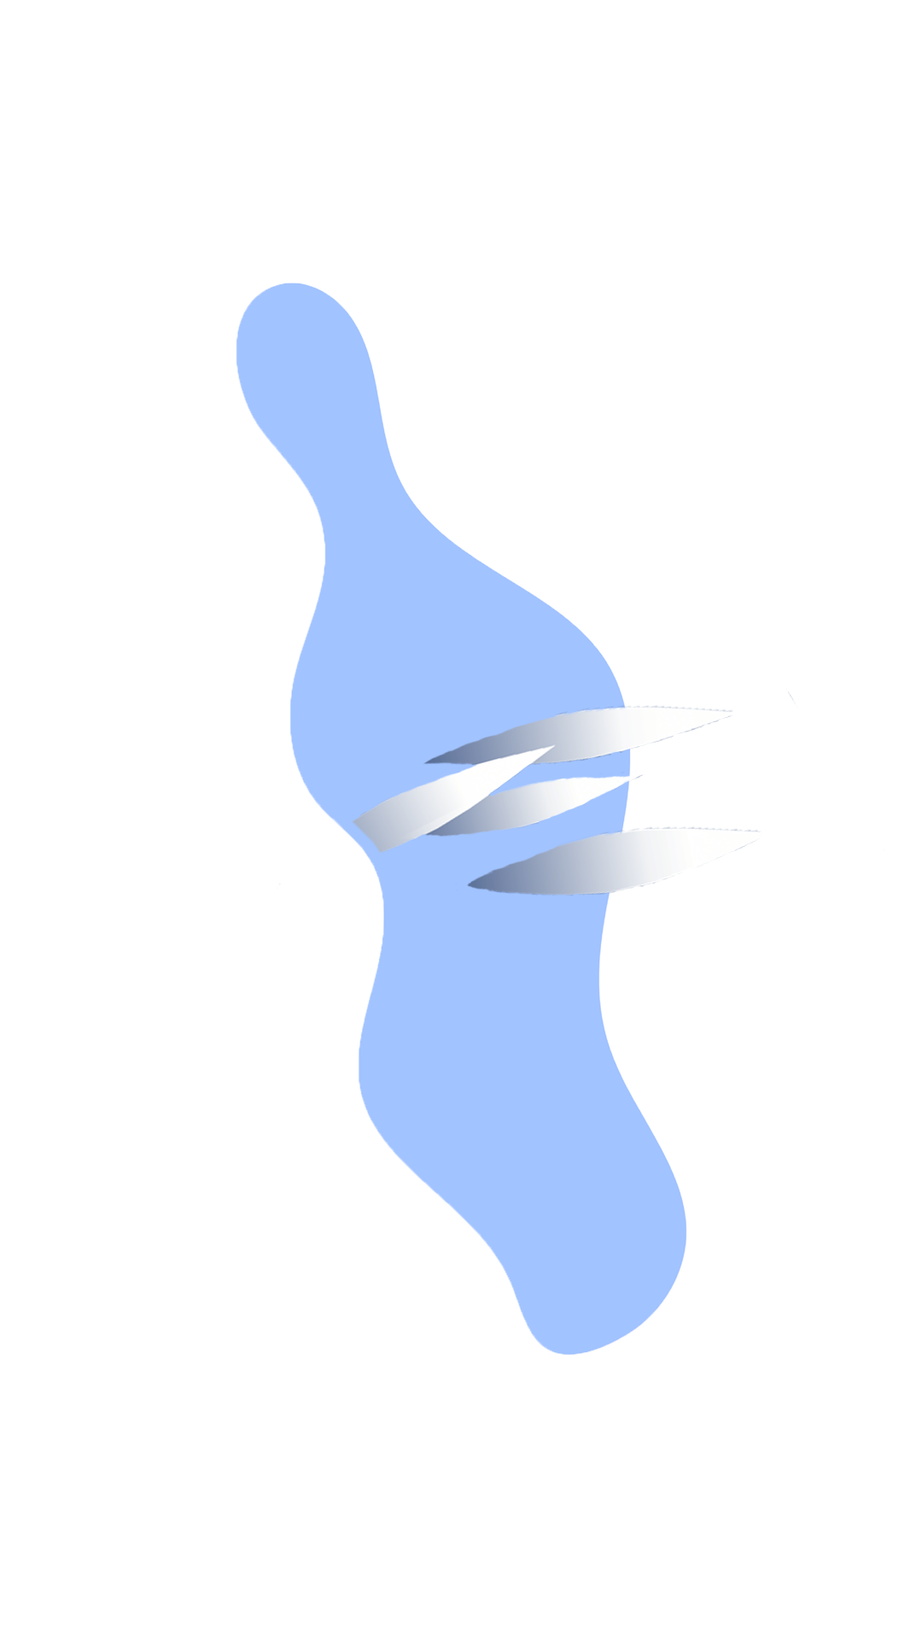
02.
Wisps
Made using Unity’s Particle System

Slide 10
Movement – Following a Path
Code
Effect
Wisps follow a path by lerping between points, the path is created when the wisps spawn, by detecting all the interactors ahead.
Wisps are made out of rotating trail objects.
A wind like beam bouncing between various objects. When about to reach the last object the wisp fades out.

Slide 11
Interaction
Code
Effect
On the generation of the path all interactor effects are applied.
Paths are generated by the Beam Spawner object.
Objects can be interacted with, if it is in the beams path, allowing for customisable effects.

Slide 12
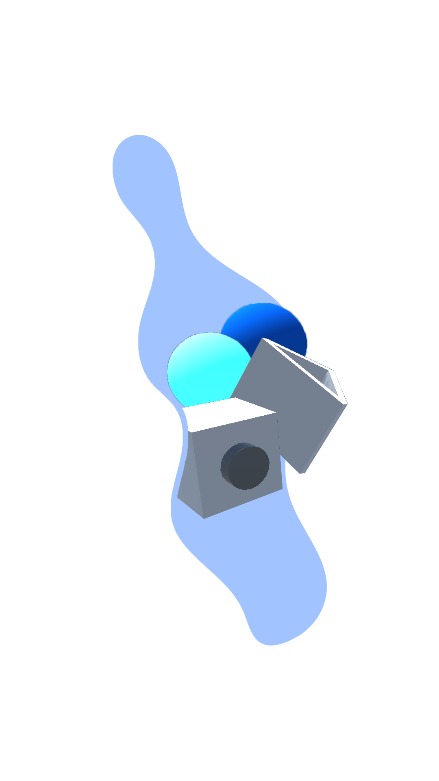
03.
Interactables
Programmer art made in the unity editor

Slide 13



Events
Called the very first frame of being found by the spawners raycast
Called when the interactor is no longer found by the raycast
OnEnter
OnStay
OnExit
Called every frame after the first, if the raycast can still find this interactor

Slide 14
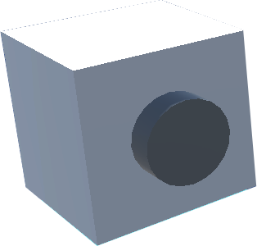
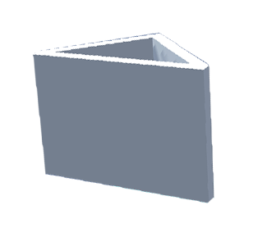


Core Interactors
Wisp Spawner
Reflector
Light
Builds a path using a raycast when it hits another interactor it runs their events.
The OnEnter and OnStay event reflects the raycasts vector along the front panels normal using Unity’s Vector3.Reflect, then continues to build the path same as the spawner
OnEnter event toggles the light on, OnExit toggles the light off. Lights switch between two materials depending on their state.

Slide 15

04.
Cross-Platform
Unity allows building to multiple platforms

Slide 16
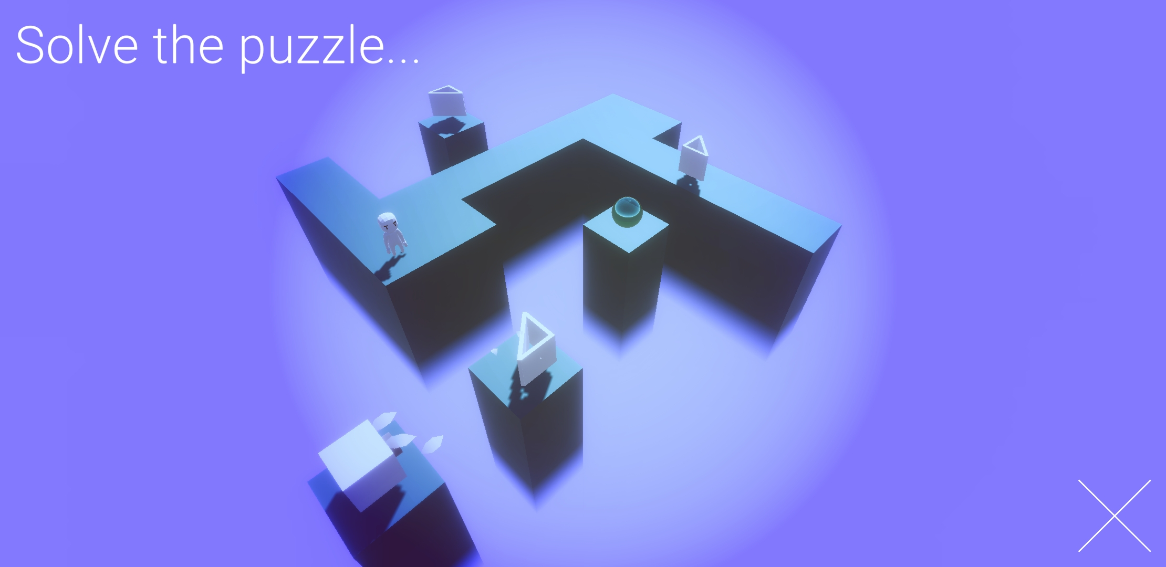
Android
Journey Through Crystal Peaks is compatible with android devices and uses touch-based input to move and interact with the game.

Slide 17
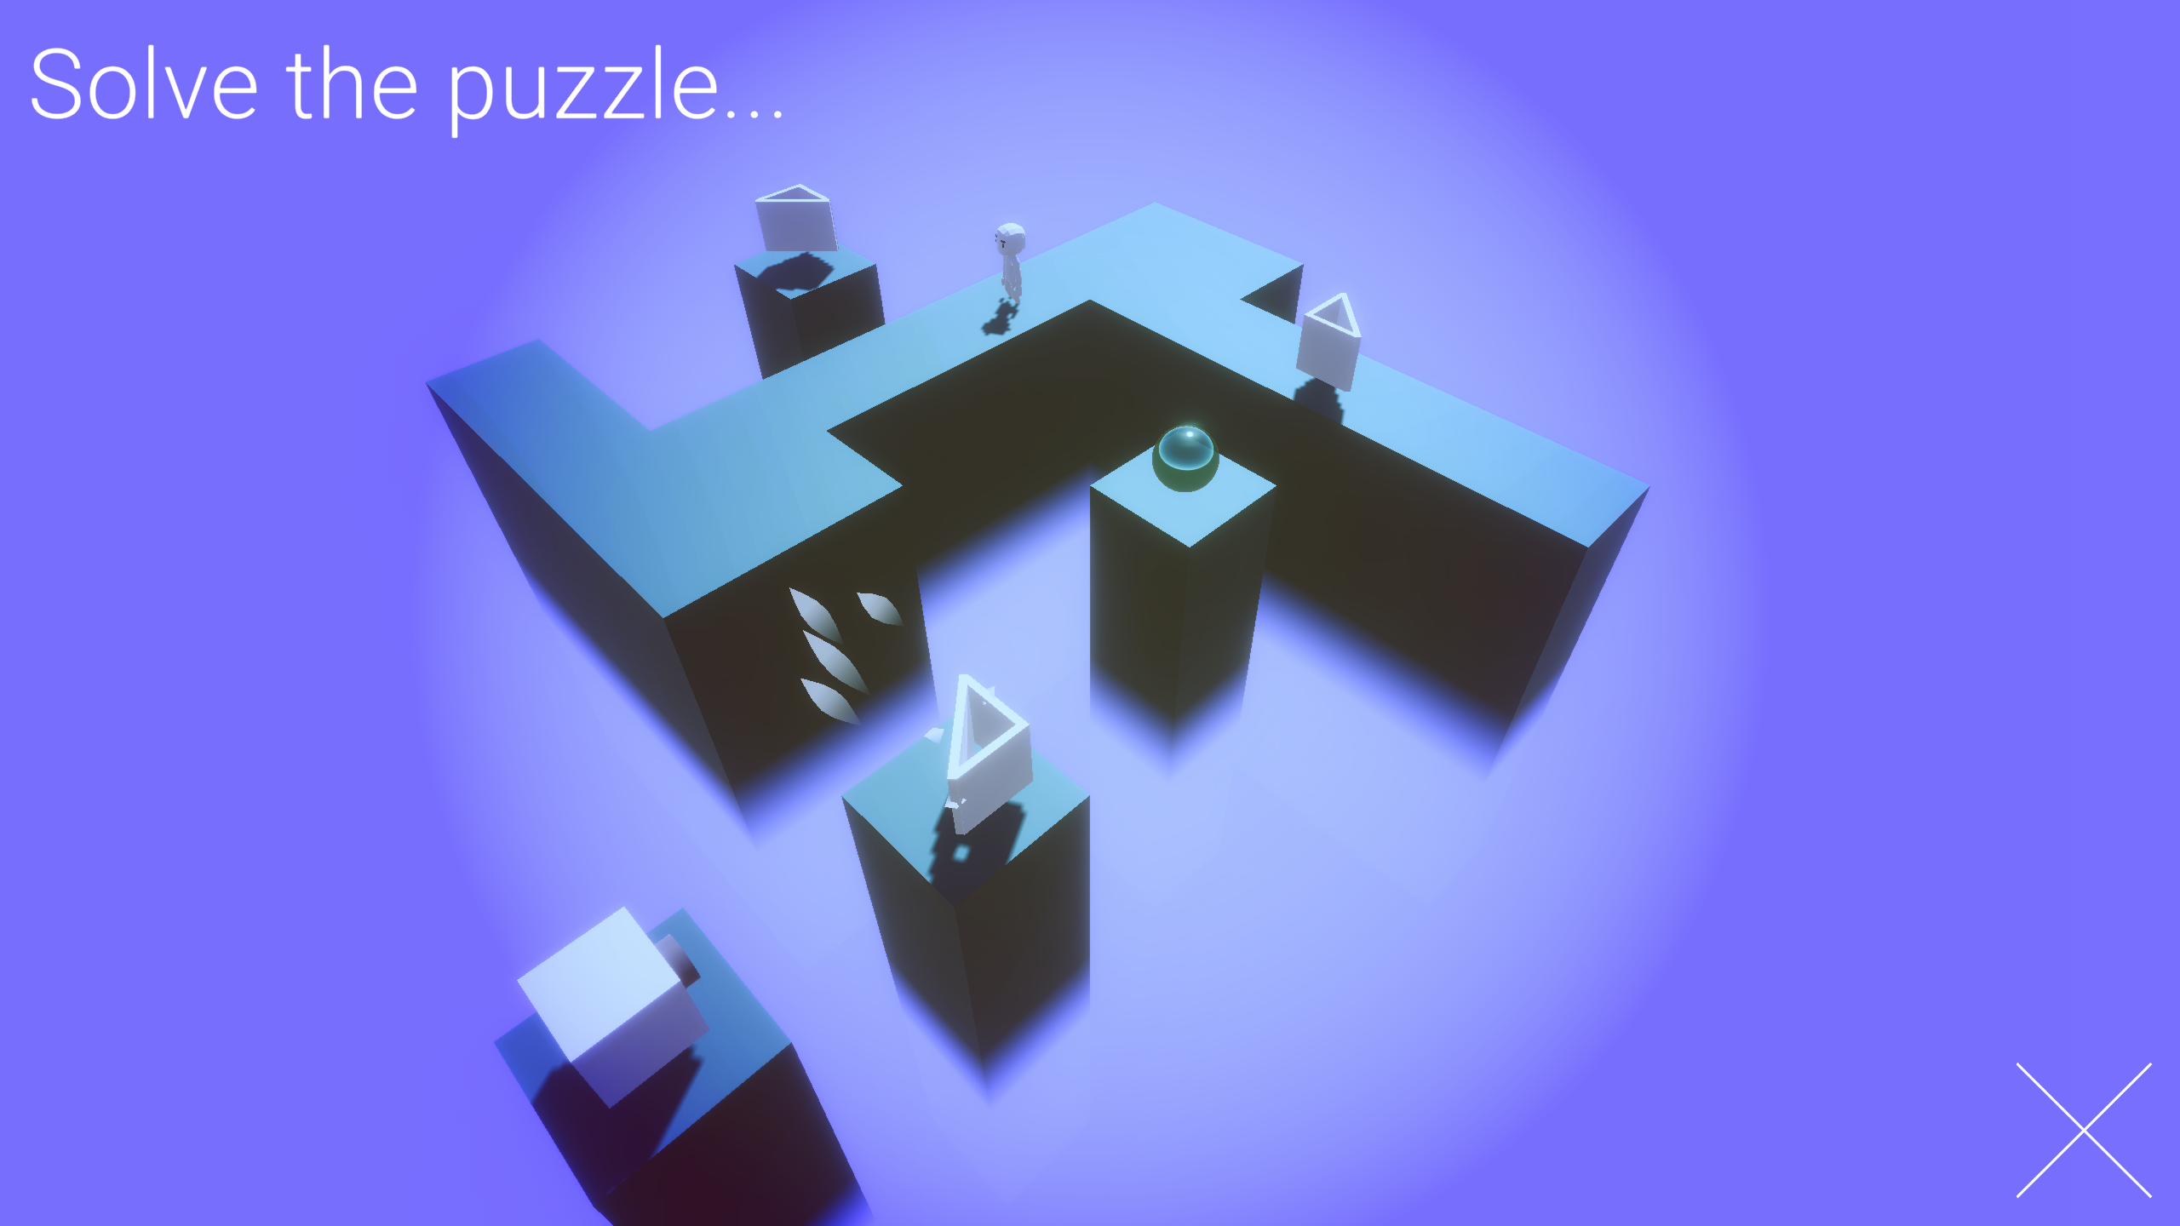
Windows
Journey Through Crystal Peaks is compatible with windows using mouse input to move and interact with the game.

Slide 18
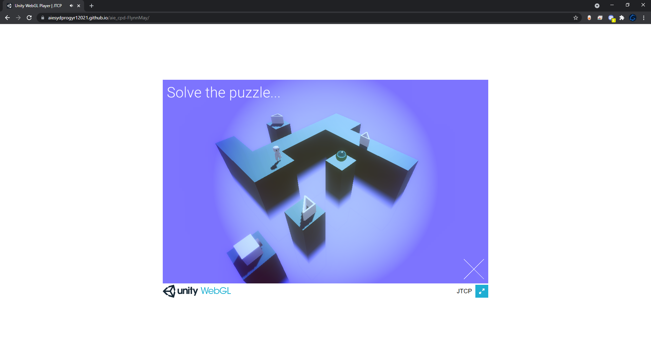
HTML5 WebGl
Journey Through Crystal Peaks is compatible with through a browser using mouse input to move and interact with the game.

Slide 19
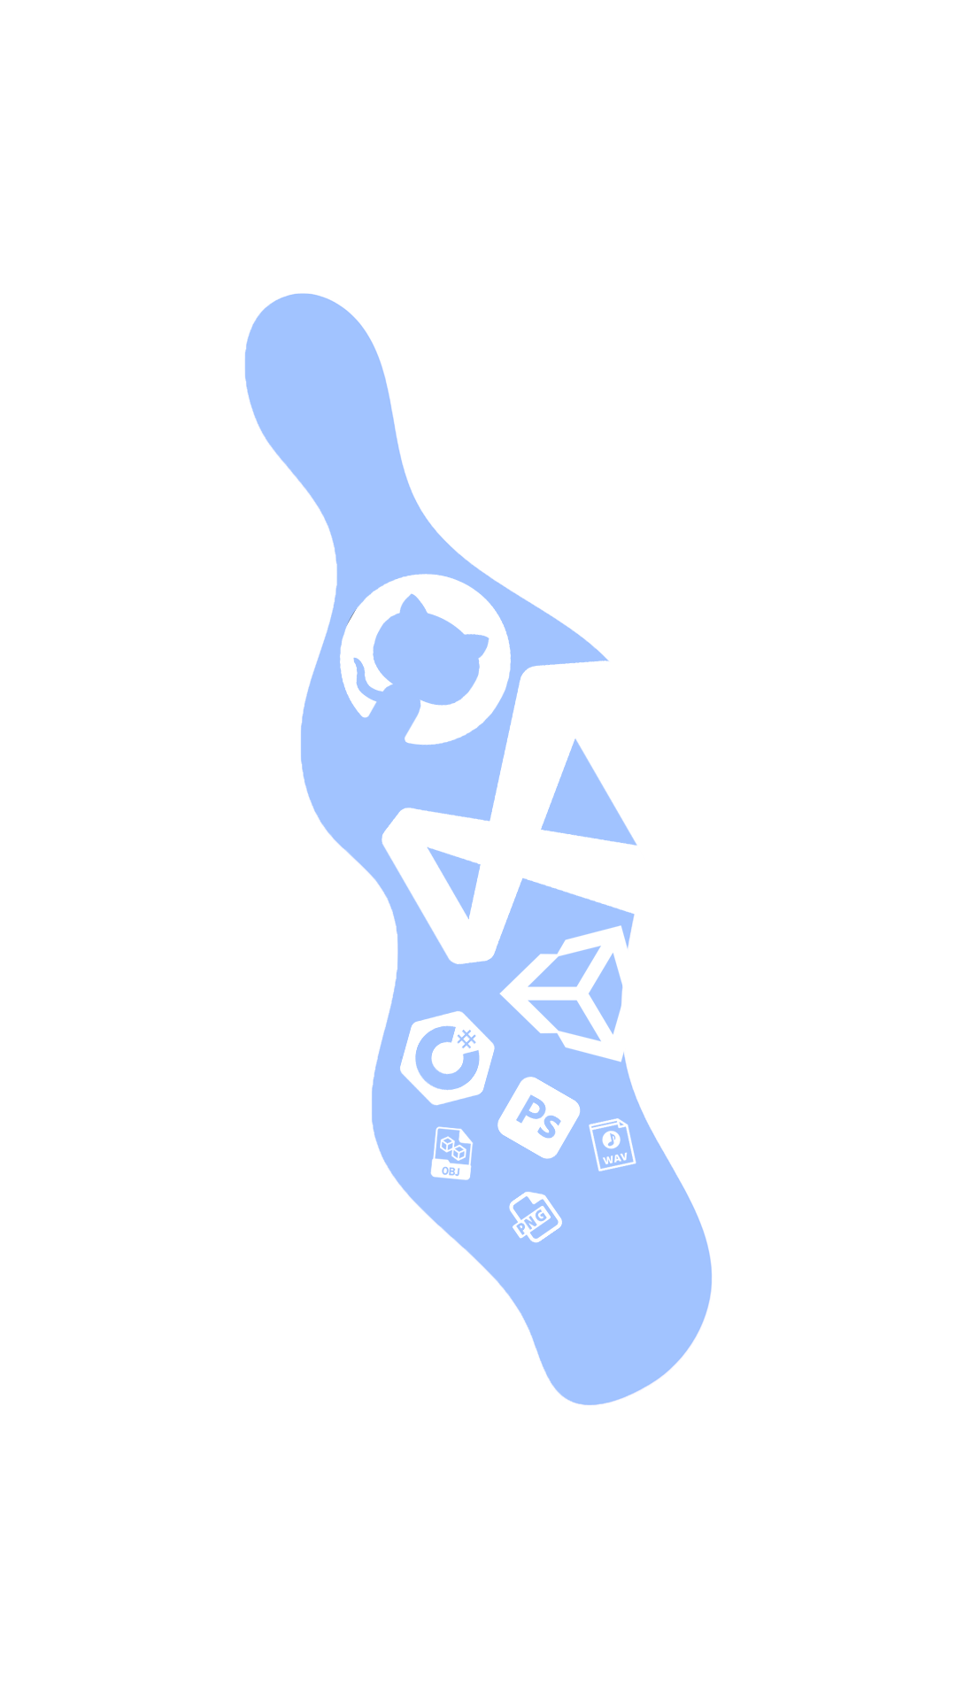
05.
Assets & Software
Unity is our game engine of choice

Slide 20



Software Used
Visual Studio
Unity
GitHub
A Microsoft IDE with unity development support.
An all-in-one game engine with a custom C# scripting API, used to build our game.
Backing up work, and file sharing.

Slide 21


Software Used
C#
Photoshop
A unity supported object-orientated programming language.
A photo editing software used to plan out the game, and mockup wireframes

Slide 22


Assets Used
URP Vertical Fog
Ult. Animated Character Pack
Adventure Music Pack
A unity asset made by LushkinR, used for the void
A character pack made by Quaternius, Used for the player model
A music pack made by Fred Patry, Used as background music

Slide 23
Assets Used
Wind
A sound pack made by IgnasD, Used for the wisps sound

Slide 24
06.
GUI Wireframes
Draw.io is an easy to use wireframe tool

Slide 25
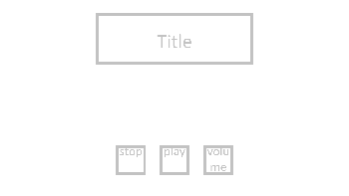
Main Menu
Title
Displays the game name
Quit Button
Volume Button
Quits the app
Takes the user to the volume screen.
Play Button
Takes the user to the level select screen

Slide 26
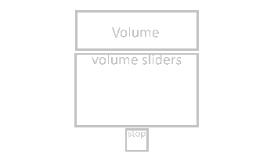
Volume
Screen Title
Displays menu name
Volume Sliders
Menu Button
This will contain the, Master, Music & SFX volume sliders
Takes the user to the main menu screen

Slide 27
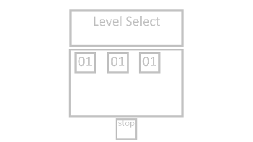
Level Select
Screen Title
Displays menu name
Level Buttons
Menu Button
Each button will take the user to the matching level indicated on the button
Takes the user to the main menu screen

Slide 28
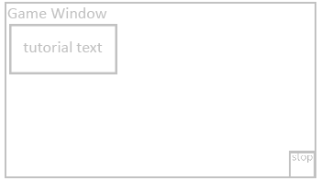
Game
Tutorial Text
Text which will tell the player about a new mechanic
Game Window
Menu Button
Displays the game.
Takes the user to the main menu screen

Slide 29
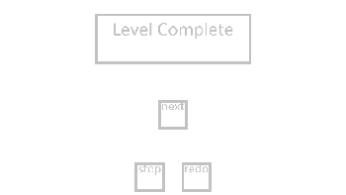
Level Complete
Complete Text
Redo Button
Tells the player they completed the level
Replays the last level
Next Button
Menu Button
Takes the user to the next level if it exists, otherwise it will return them to the menu
Takes the user to the main menu screen

